Slide 1


Beihang University, China
QRS
2017
Which Factor Impacts GUI Traversal-Based Test Case Generation Technique Most?
— A Controlled Experiment on Android Applications
Bo Jiang & Yaoyue Zhang, Beihang University
W.K. Chan, City Univeristy of Hong Kong
Zhenyu Zhang, Chinese Academy of Sciences, Institute of Software

Slide 2

Outline
1
BACKGROUND & RELATED WORK
2
TEST CASE GENERATION FRAMEWORK
3
DESIGN FACTORS
4
CONTROLLED EXPERIMENT
5
CONCLUSION

Slide 3

Outline
1
BACKGROUND & RELATED WORK
2
TEST CASE GENERATION FRAMEWORK
3
DESIGN FACTORS
4
CONTROLLED EXPERIMENT
5
CONCLUSION

Slide 4
Background
4
1
Android Applications requires testing for ensure quality
2
Automated test case generation techniques are major research focus.
3
StateTraversal: one of the most popular type of techniques.

Slide 5
Related Work
5
1
Automated Test Input Generation for Android: Are We There Yet?
R. C. Shauvik et al. (ASE2015)
2
SwiftHand: Guided GUI Testing of Android Apps with Minimal Restart and Approximate Learning. W. Choi et al. (OOPSLA2013)
3
PUMA: Programmable UI-automation for large-scale dynamic analysis of mobile apps. S. Hao, B. Liu et al. (MobiSys2014)
4
Acteve: Automated Concolic Testing of Smartphone Apps.
S. Anand et al. (FSE2012)

Slide 6
Outline
1
BACKGROUND & RELATED WORK
2
TEST CASE GENERATION FRAMEWORK
3
DESIGN FACTORS
4
CONTROLLED EXPERIMENT
5
CONCLUSION

Slide 7
Test Case Generation Framework
7
PUMA Framework

Slide 8
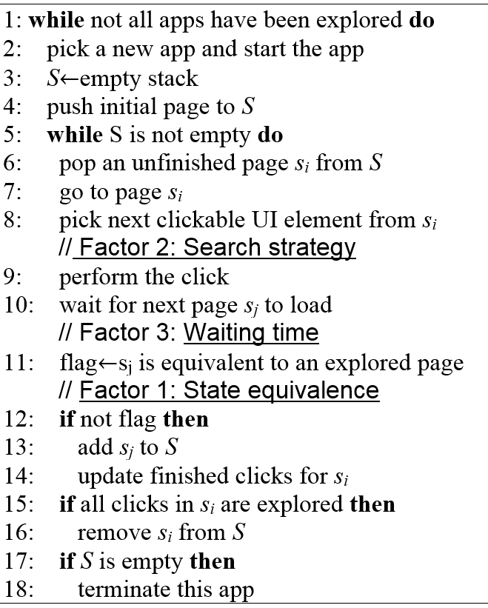
Test Case Generation Framework
8
Generic Framework
Generic GUI Traversal-based Test Case generation framework of PUMA
⁰¹
State equivalence
⁰²
Search strategy
⁰³
Waiting time

Slide 9
Outline
1
BACKGROUND & RELATED WORK
2
TEST CASE GENERATION FRAMEWORK
3
DESIGN FACTORS
4
CONTROLLED EXPERIMENT
5
CONCLUSION

Slide 10
Design Factors
10
⁰¹
State Equivalence
02
Cosine
Eigenvectors of the UI widgets.
Threshold: 0.95
DECAF&PUMA
ActivityID
UIAutomator's API getCurrentActivityName().
String comparison.
A3E
UI Hierarchy
Use Widgets tree structure to represent .
The widgets trees are the same.
SwiftHand
01
03

Slide 11
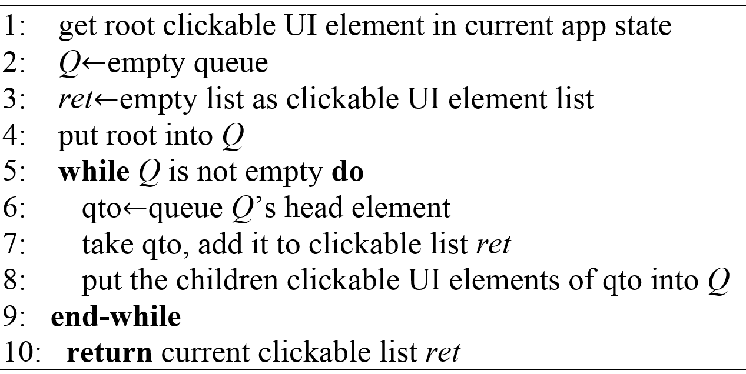
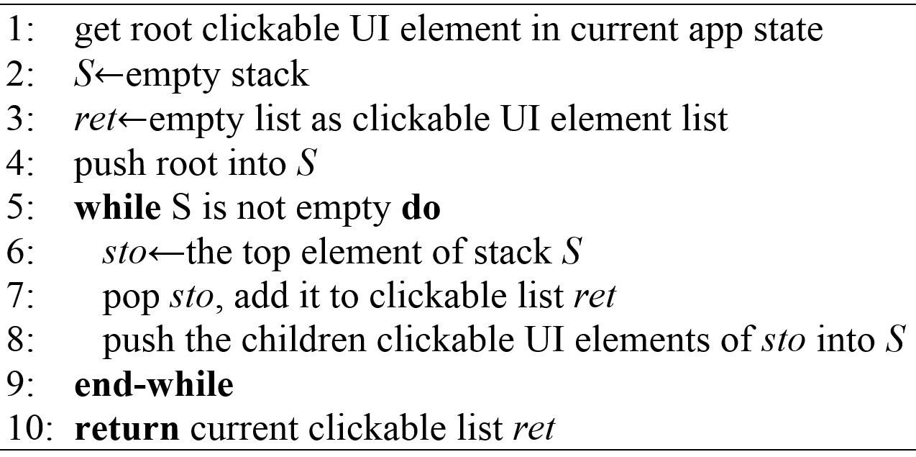
Design Factors
11
⁰²
Search Strategy
BFS PUMA
DFS A3E
Rand monkey

Slide 12
Design Factors
11
⁰³
Waiting Time (between Two Events)
Strategy | Used By
watiForIdle | PUMA
wait200ms | Monkey used by Shauvik et al in ASE 2015
wait3000ms | Acteve
wait5000ms | Swifthand

Slide 13
Design Factors
12
Three Factors and Their Levles
Factor Level | Factor 1: State Equivalence | Factor 2: Search Strategy | Factor 3: Waiting Time
0 | Cosine | BFS | waitForIdle
1 | UI Hierarchy | DFS | wait200ms
2 | ActivityID | Random | wait3000ms
3 | — | — | wait5000ms

Slide 14
Outline
1
BACKGROUND & RELATED WORK
2
TEST CASE GENERATION FRAMEWORK
3
DESIGN FACTORS
4
CONTROLLED EXPERIMENT
5
CONCLUSION

Slide 15
Controlled Experiment
14
⁰¹
Benchmarks and Experimental Setup
33 real-world open-source mobile apps
from Dynodroid, A3E, ACTEve, SwiftHand.
We implemented all factor levels
in the PUMA framework.
Two virtual machines installed with
ubuntu 14.04 operating systems.

Slide 16
Controlled Experiment
15
⁰²
Experimental Procedure
36 (i.e., 3*3*4) combinations of factor levels for the three factors.
Took 1188 testing hours in total on 2 virtual machines.
ANOVAs(one-way ANalyses Of VAriances)
Multiple comparison

Slide 17
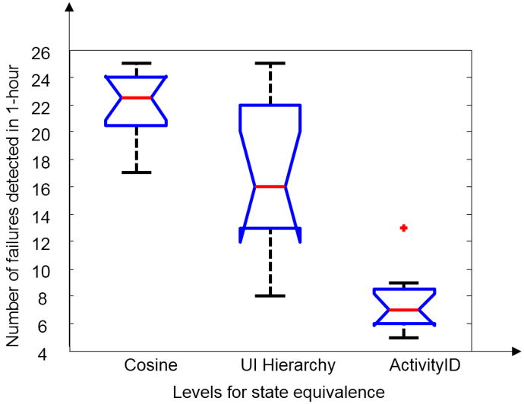
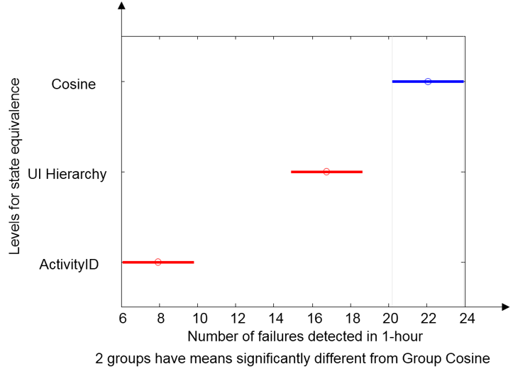
Controlled Experiment
16
⁰³
Results and Analysis-state equivalence

Slide 18
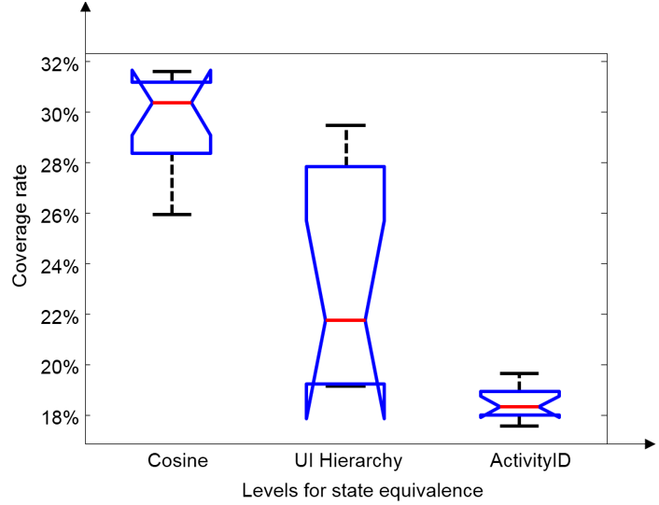
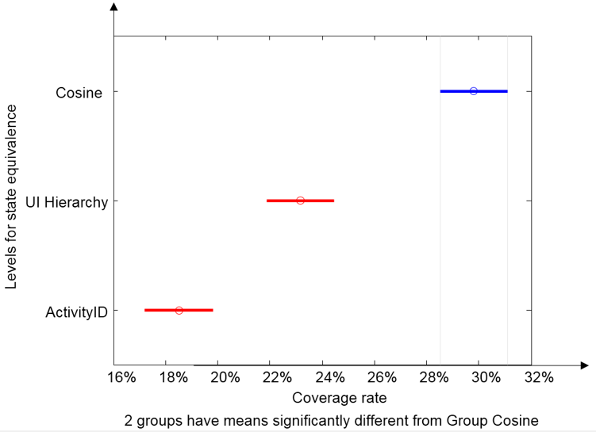
Controlled Experiment
17
⁰³
Results and Analysis-state equivalence

Slide 19
Controlled Experiment
18
⁰³
Results and Analysis-state equivalence
Cosine Similarity > UI Hierarchy > ActivityID in
Failure detection ability
Code coverage rate

Slide 20
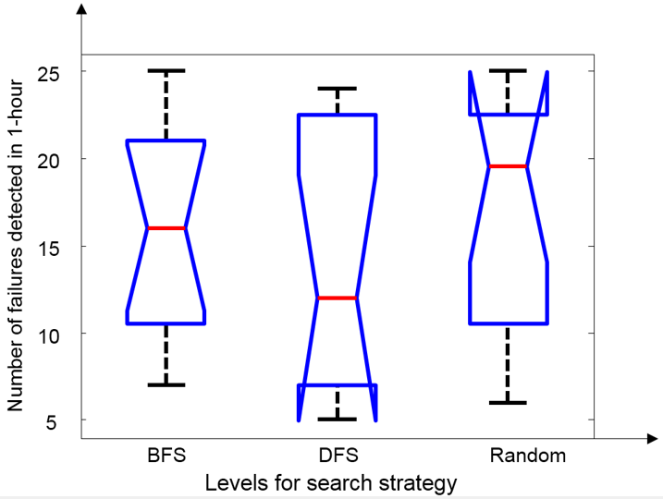
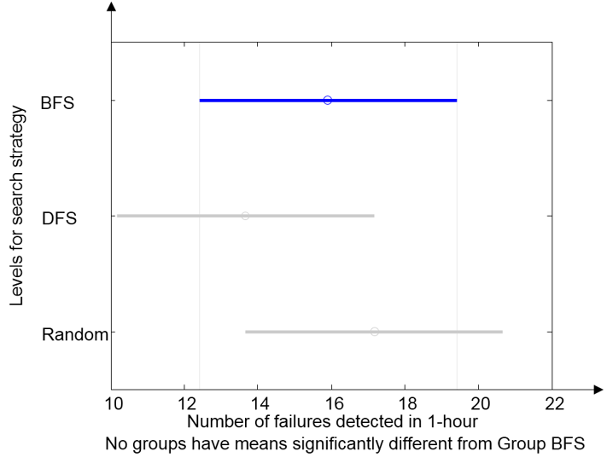
Controlled Experiment
19
⁰³
Results and Analysis-search strategy

Slide 21
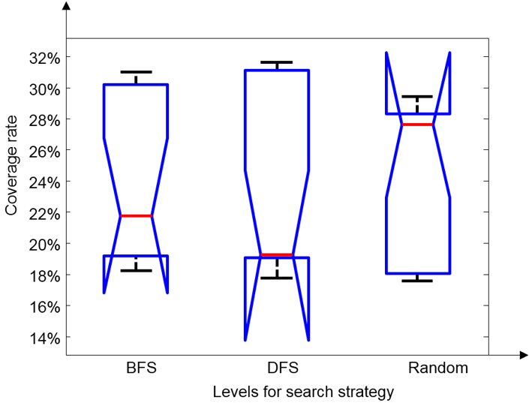
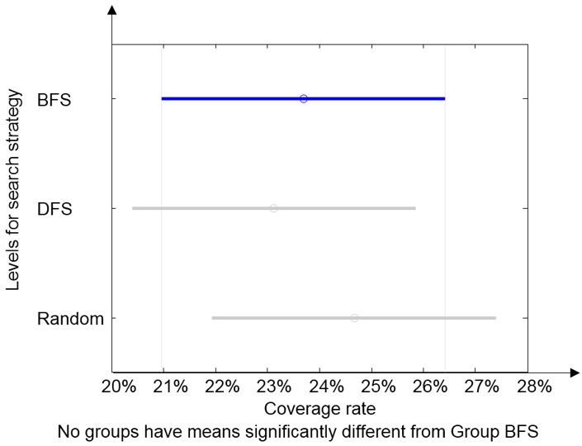
Controlled Experiment
20
⁰³
Results and Analysis-search strategy

Slide 22
Controlled Experiment
21
⁰³
Results and Analysis-search strategy
Randomized search strategy was statistically comparable to BFS and DFS in
Failure detection ability
Code coverage rate

Slide 23
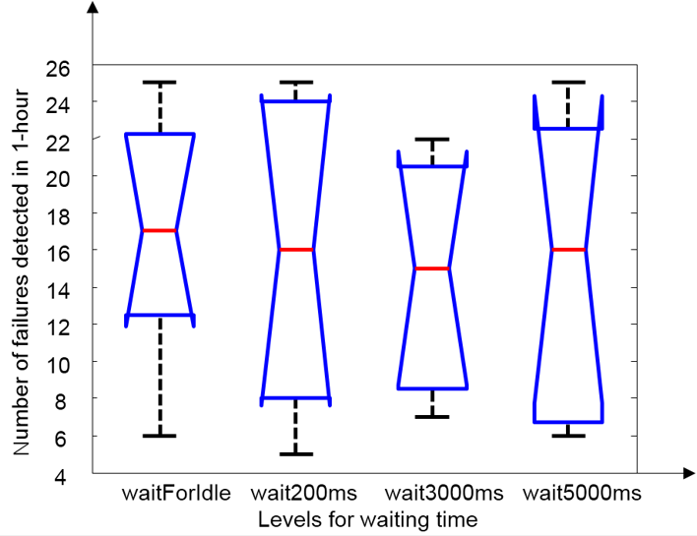
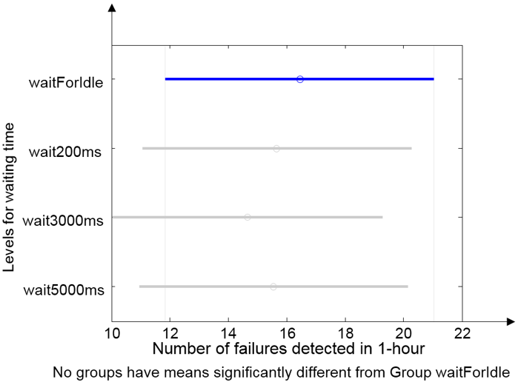
Controlled Experiment
22
⁰³
Results and Analysis-waiting time

Slide 24
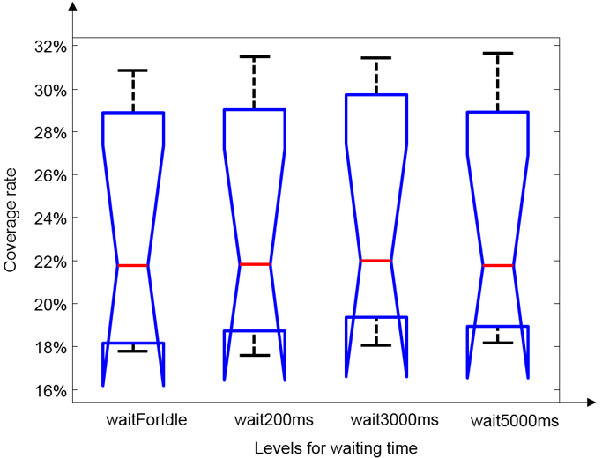
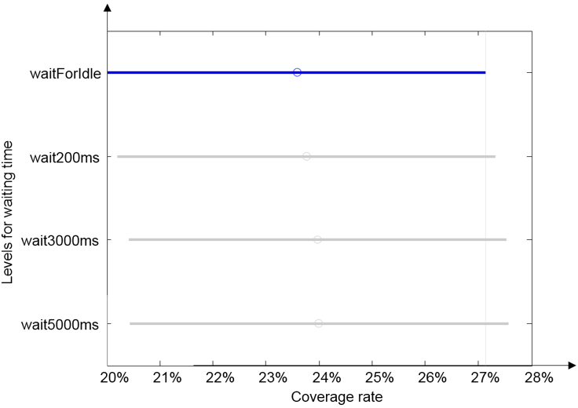
Controlled Experiment
23
⁰³
Results and Analysis-waiting time

Slide 25
Controlled Experiment
25
⁰³
Results and Analysis-waiting time
The strategy to wait until GUI state is stable before sending the next input event is not statistically more effective than the strategy of waiting for a fixed time interval in
Failure detection ability
Code coverage rate

Slide 26
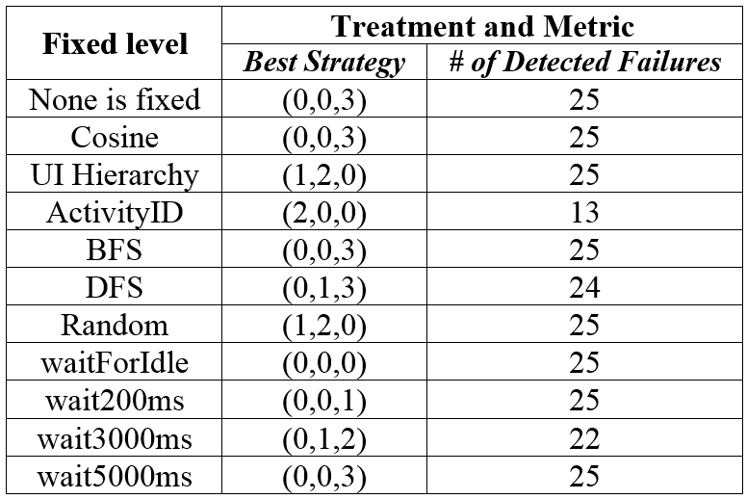
Controlled Experiment
25
⁰³
Results and Analysis-Best Treatment-Failure Detection Rate

Slide 27
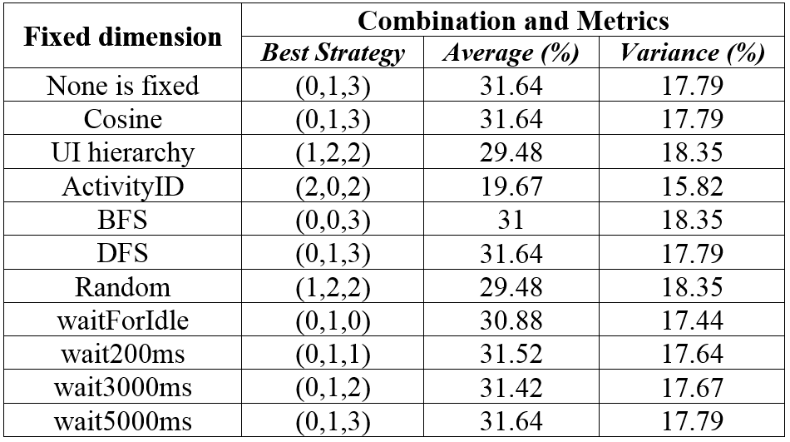
Controlled Experiment
26
⁰³
Results and Analysis-Best Treatment-Code Coverage

Slide 28
Controlled Experiment
27
⁰³
Results and Analysis-Best Treatment
There were many combinations of factor levels can attain the same high level of failure detection rate and high level of statement code coverage
There could be many good configurations in configuring StateTraversal.

Slide 29
Outline
1
BACKGROUND & RELATED WORK
2
TEST CASE GENERATION FRAMEWORK
3
DESIGN FACTORS
4
CONTROLLED EXPERIMENT
5
CONCLUSION

Slide 30
Conclusion
29
State equivalence :Different state equivalence definitionswill significantly affect the failure detection rates and the code coverage.
Search strategy: BFS and DFS are comparable to Random.
Waiting time: Waiting for idle and waiting for a fixed time period have no
significant difference.
Failure detection rate: <Cosine Similarity, BFS, wait5000ms>(best).
Code coverage:<Cosine Similarity, DFS, wait5000ms>(best).

Slide 31
THANKS
Q&A

